Slide 1




Localized Speech-to-Text for Inclusive Learning
Pranav H – BL.EN.U4AIE21105
Mayank Pandey – BL.EN.U4AIE21079

Slide 2

Table of Contents
Introduction
Literature Review
a) Communication-efficient Personalized Federated Learning For Speech-to-text Tasks
b) Performance Evaluation of Keyword Extraction Techniques and Stop Word Lists on Speech-To-Text Corpus

Slide 3

Introduction
Converting a users speech to text locally on device without the use of any cloud or external processing.

Slide 4
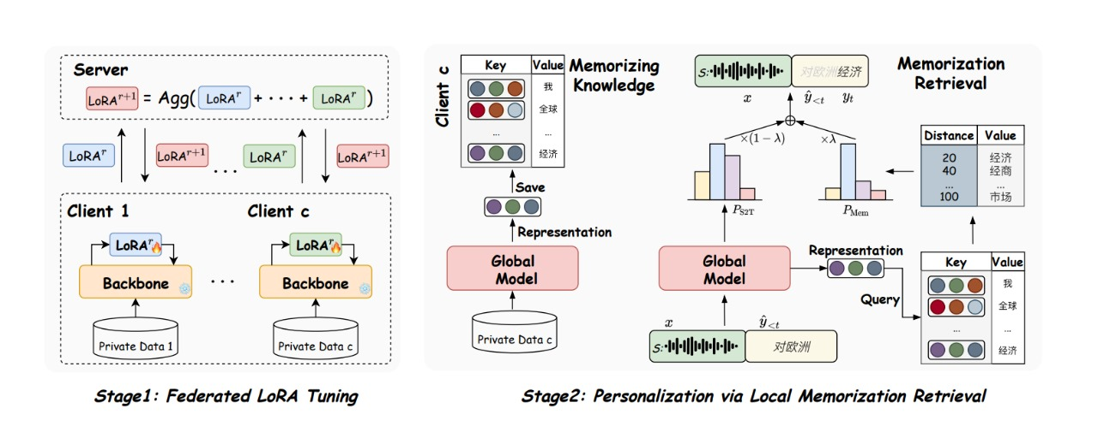
Communication-efficient Personalized Federated Learning For Speech-to-text Tasks

Slide 5
Communication-efficient Personalized Federated Learning For Speech-to-text Tasks
FEDLORA
This is a lightweight Low-Rank Adaptation (LoRA) module designed for efficient training of the global model. It is used for client-side tuning and interaction with the server to minimize communication overhead.
FEDLORA employs LoRA as the object to be interacted with and updated. The LoRA tuning technique is used to efficiently train the global model.
FEDMEM
This is a global model equipped with a k-nearest-neighbour (KNN) classifier that captures client-specific distributional shifts to achieve personalization.
FEDMEM employs client-specific memorization retrieval for personalization to address data heterogeneity.
Federated Learning :
Collaborative
Decentralized
Machine Learning & Model Training.
2 Tier Approach :
Global – FEDMEM
Local / On Device - FEDLORA

Slide 6
Communication-efficient Personalized Federated Learning For Speech-to-text Tasks
Advantages
Communication Efficiency: FEDLORA employs a lightweight LoRA module for client-side tuning, which minimizes communication overhead during model training.
Personalization: FEDMEM uses a k-nearest-neighbor (kNN) classifier for client-specific memorization retrieval, which on augmented with FEDLORA at the individual level captures local distribution shifts and personalizing the global model.
Scalability: The proposed approach is more scalable for large-scale settings, reducing communication overhead significantly compared to traditional methods.

Slide 7
Communication-efficient Personalized Federated Learning For Speech-to-text Tasks
Challenges
Hardware Heterogeneity: Clients exhibit heterogeneous hardware capabilities, making it difficult to accommodate the requirements for whole-model training and communication.
Data Distribution Heterogeneity: Speech data distribution exhibits severe heterogeneity (e.g., variations in environmental noise, accents, domains, microphone conditions), which can lead to parameter divergence.

Slide 8
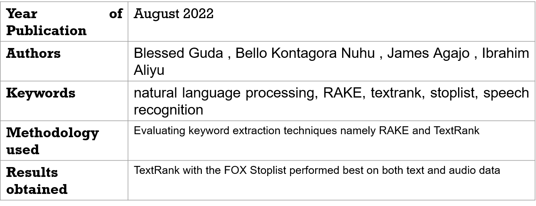

Performance Evaluation of Keyword Extraction Techniques and Stop Word Lists on Speech-To-Text Corpus
Guda, B., Nuhu, B.K., Agajo, J. and Aliyu, I., 2023. Performance Evaluation of Keyword Extraction Techniques and Stop Word Lists on Speech-To-Text Corpus. Int. Arab J. Inf. Technol., 20(1), pp.134-140.

Slide 9
Thank you

